Slide 1
MINI PROJECT-II PRESENTATION (2020-21) MERN Stack Based Application “GEEK SEEK”
Submitted by –
Rohan Bhardwaj (181500589)
Shashank Kumar Pandey (181500654)
Shivani Chauhan (181500678)
Vanshika Mahle (181500781)
Vimal Mishra (181500792)
Supervised by –
Mr. Anand Parkash Gupta
Technical Trainer
Department of Computer Engineering & Application

Slide 2
OVERVIEW
Geek Seek is a full stack social network application for developers to be developed using Node.js, React, Redux, MongoDB, along with Express.
The platform will be developed in two parts – Front-end development and Back- end development.
We will be building an extensive backend API using Node.js & Express and JWT will protect the endpoints. We will use Postman for testing our backend API and to handle requests.
The front-end will be integrated with the backend in an elegant way to create a great workflow. For application state management, we will use Redux and create reducers and actions for our resources. Also, we will test our application using Redux Chrome extension. The application will be deployed to Heroku using Git.

Slide 3
OBJECTIVE
The project aims to build a full stack social network application for geeks which includes user authentication, user profiles and forum posts.
The platform will be developed using MongoDB, Express, Node.js, Redux and React technologies.
The platform allows geeks to create their profile, update it or add additional details about them. They can also link their GitHub profiles by providing their GitHub username.
The geeks can view profiles of other users and get connected with each other. They can post their views in the forum section, like other’s posts and put comments too.

Slide 4
FEATURES USED
New users can create a profile and register themselves
Authentication for existing users
Viewing profiles of geeks without logging in to the account and connect
Add additional details to the profiles and edit them
Link GitHub accounts by providing the GitHub username
View five latest git repositories in the user profiles
Add posts in the forum
View and Like posts of other geeks
Comment on the posts of other geeks

Slide 5
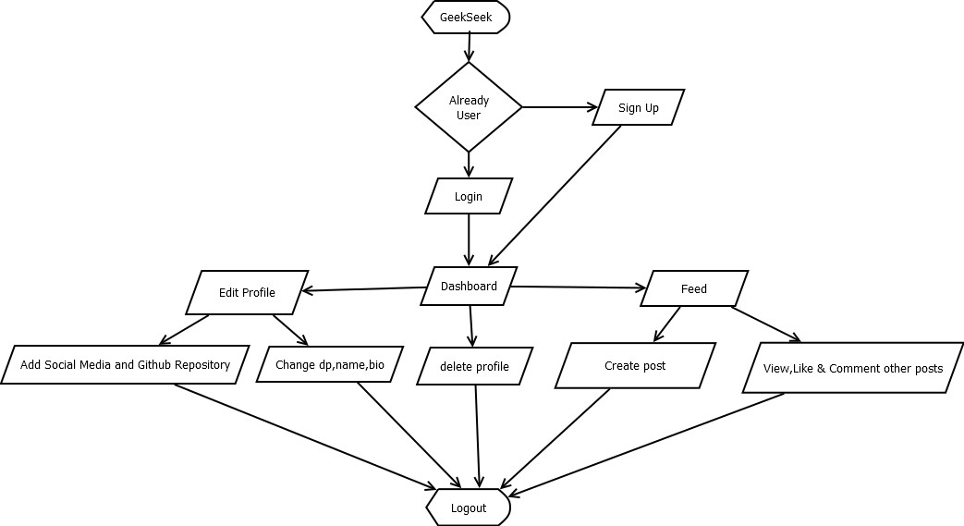
FLOW CHART

Slide 6
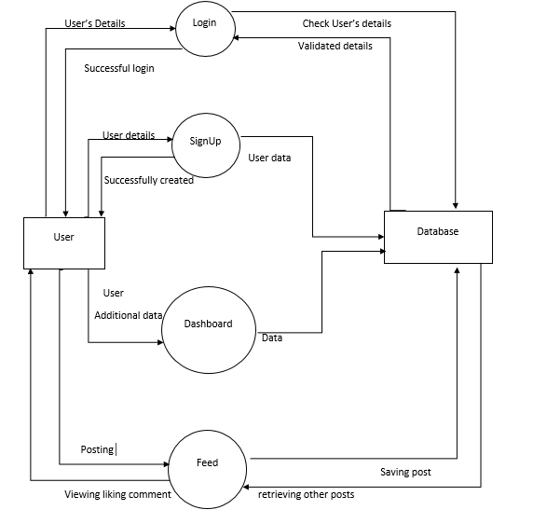
DATA FLOW DIAGRAM

Slide 7
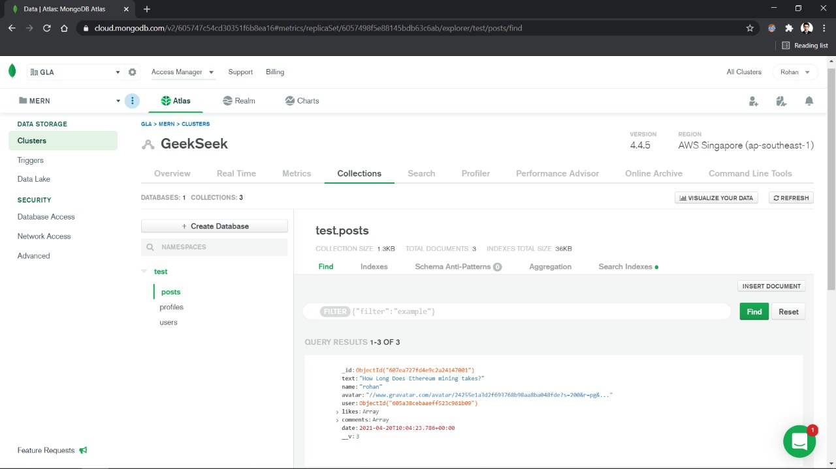
BACKEND SCREENSHOTS

Slide 8
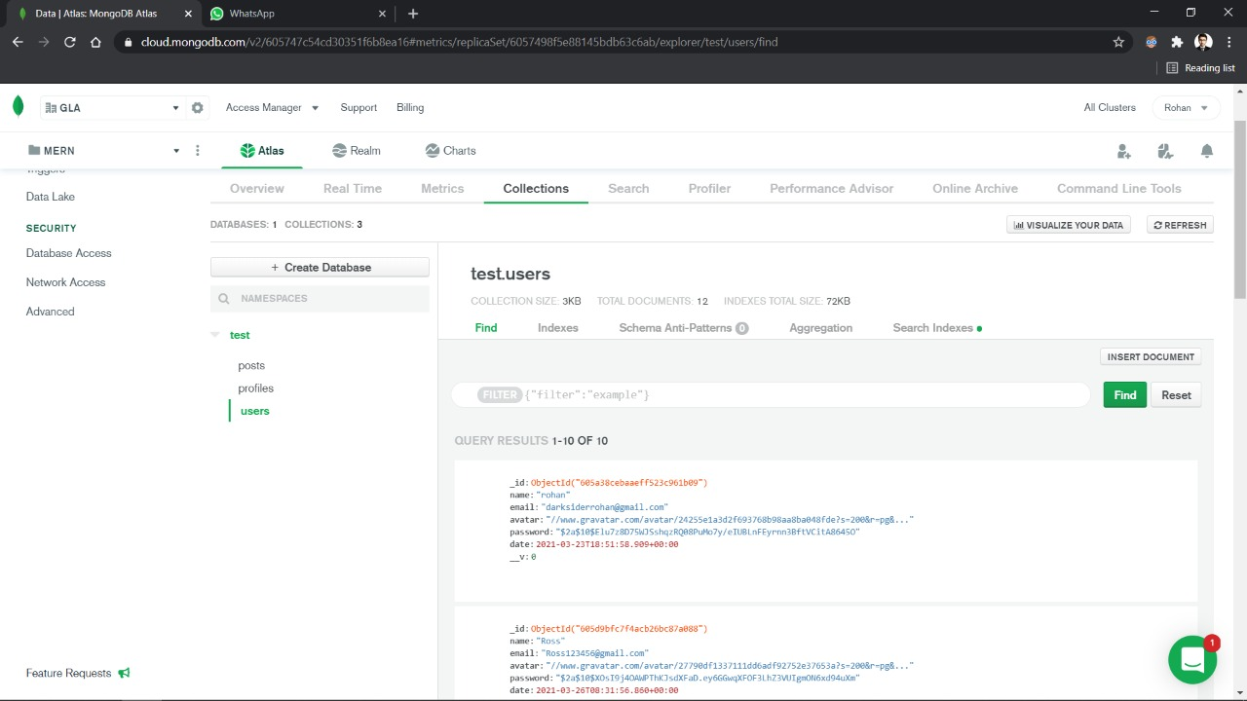

Slide 9
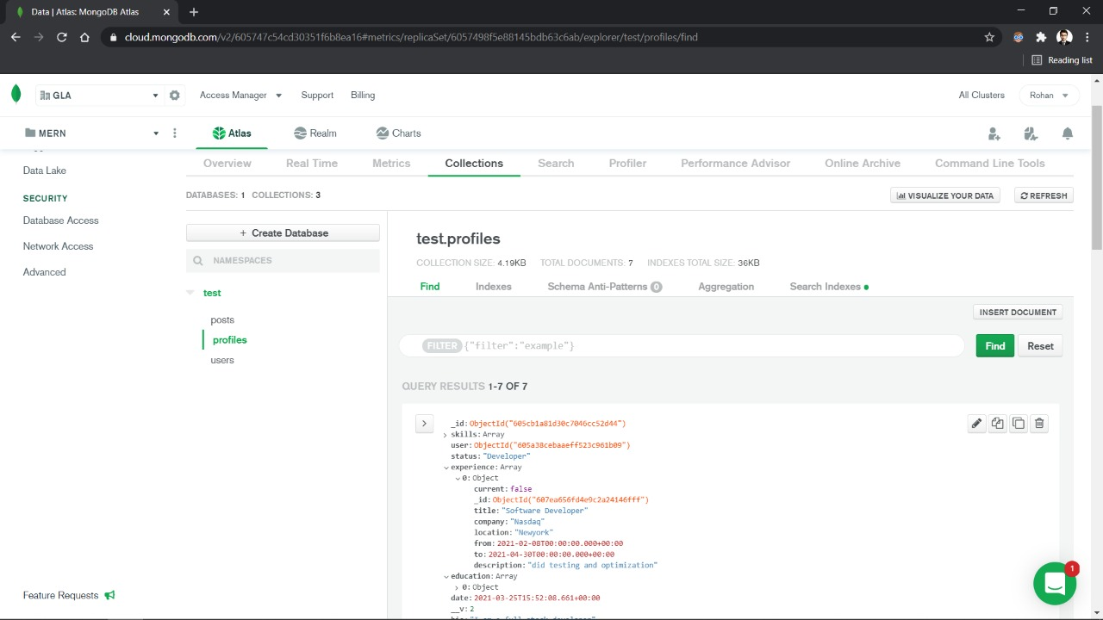

Slide 10
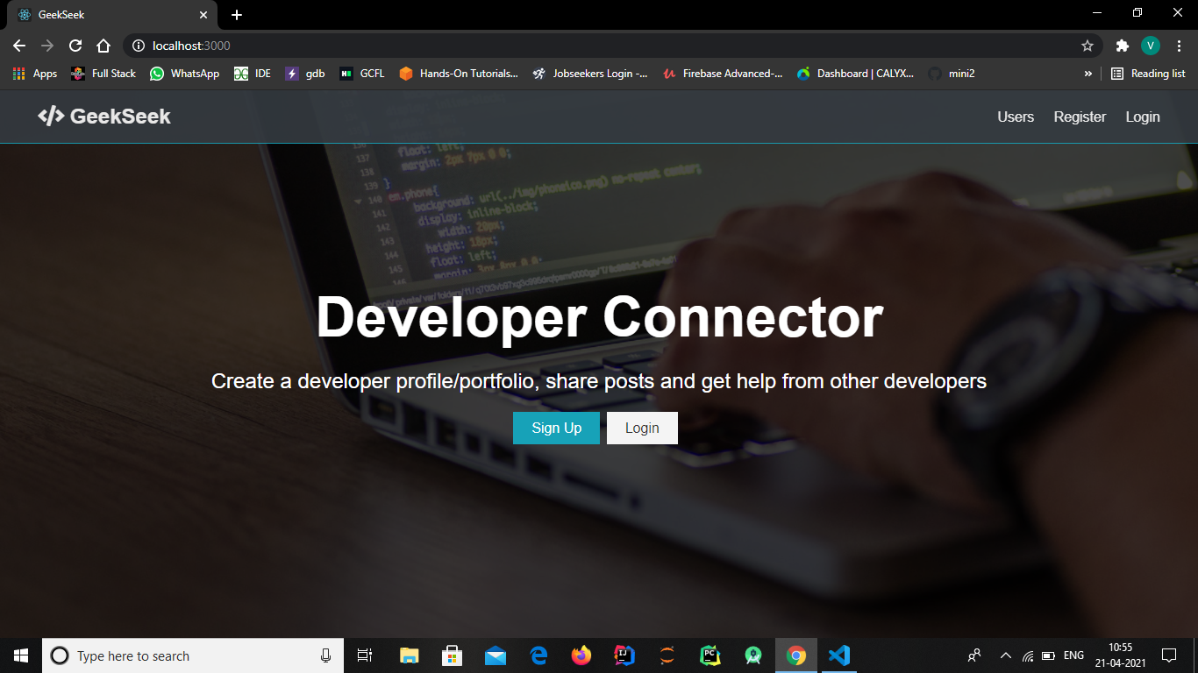
FRONTEND SCREENSHOTS

Slide 11
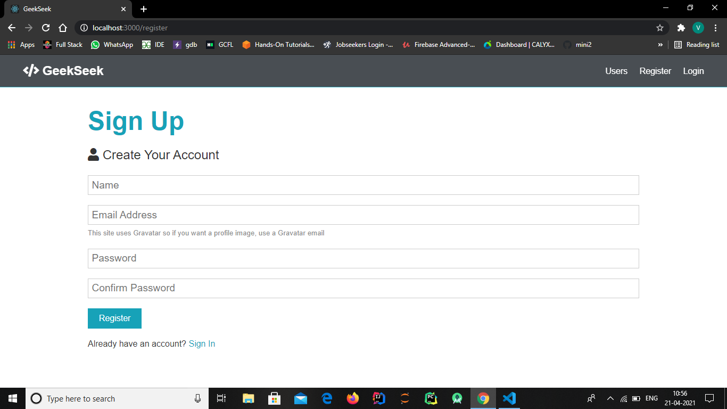

Slide 12
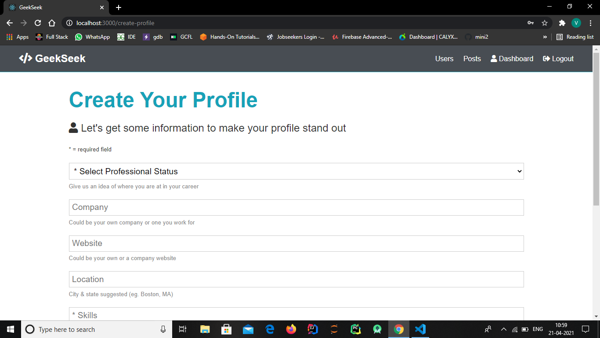

Slide 13
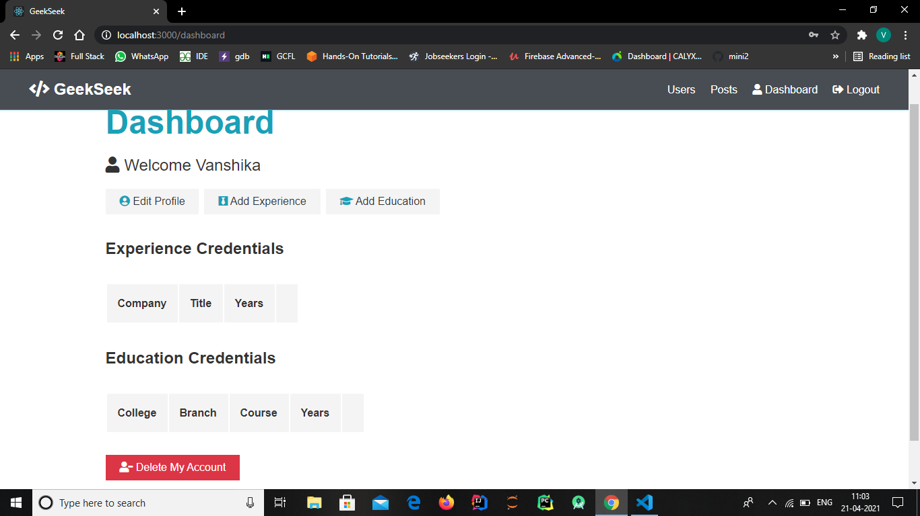

Slide 14
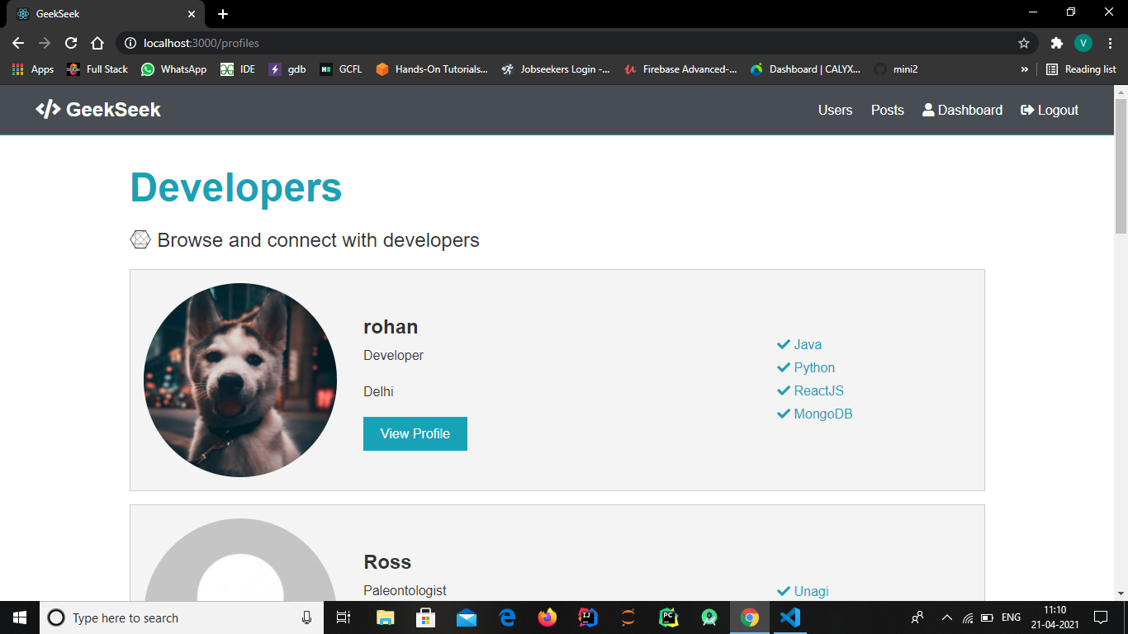

Slide 15
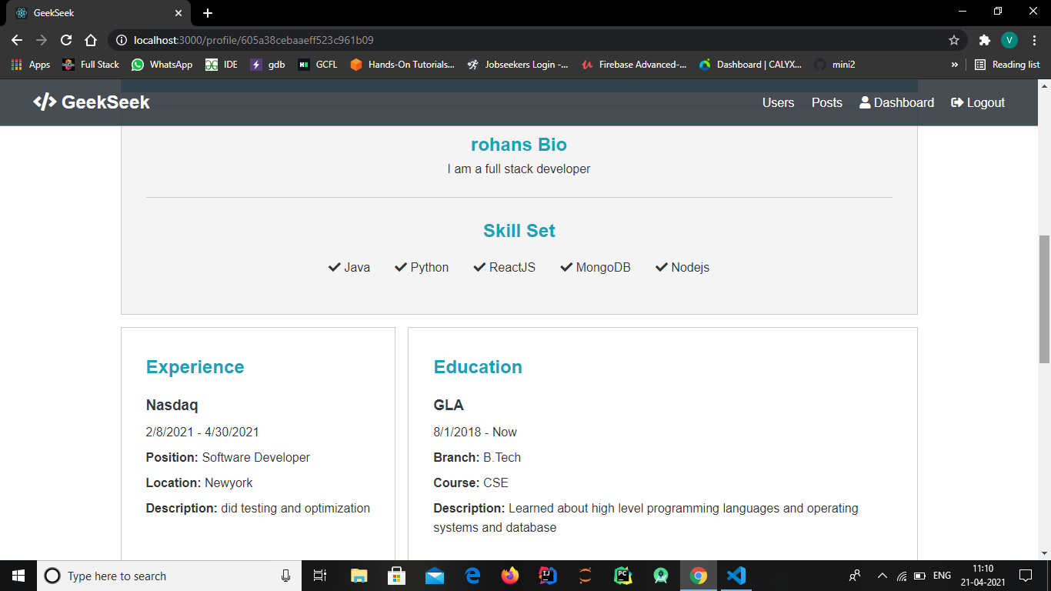

Slide 16
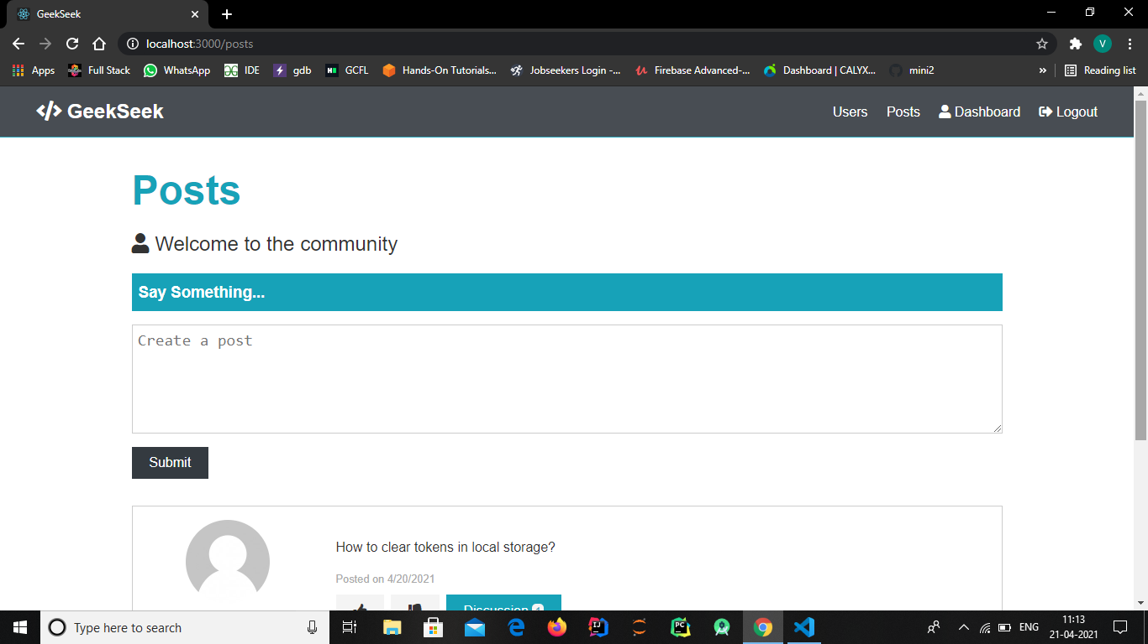

Slide 17
CONCLUSIONS
The key purpose of developing a Social Networking Site for developers is to reach out to others around the world and share knowledge, educational material, etc. This includes regular social networking material, such as accounts, images, emails, and forums, and video sharing, posts, etc. developers can create accounts, exchange and gain information, teach related lessons, etc. also by using this network, users can share information, educational books, questions/answers, and everything else.

Slide 18
REFERENCES
https://www.youtube.com/
https://www.google.com/
https://www.w3schools.com/
https://nodejs.org/en/
https://www.mongodb.com/
https://reactjs.org/
Source code link –
https://github.com/RohanBhardwaj/GeekSeek

